Slide 1
OBC Configuration

Slide 2
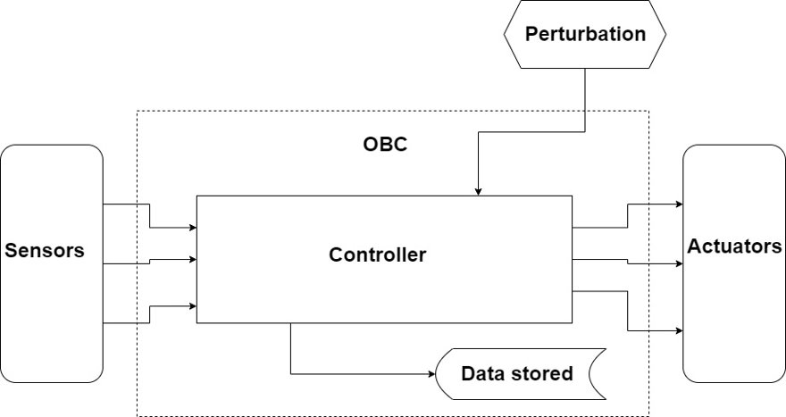

Slide 3
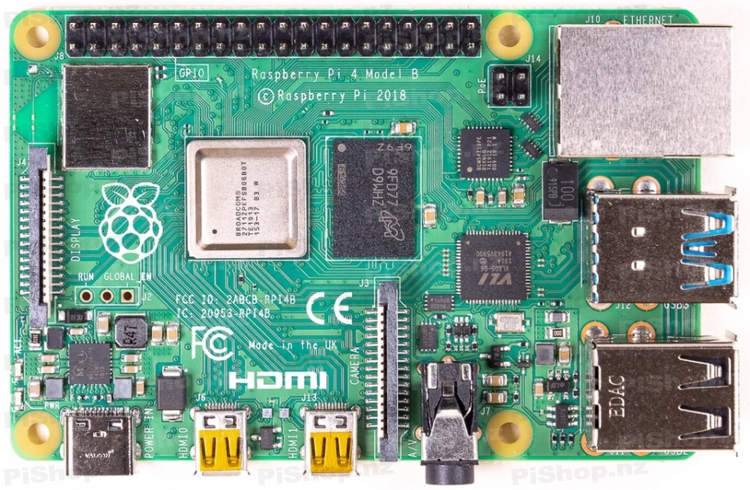
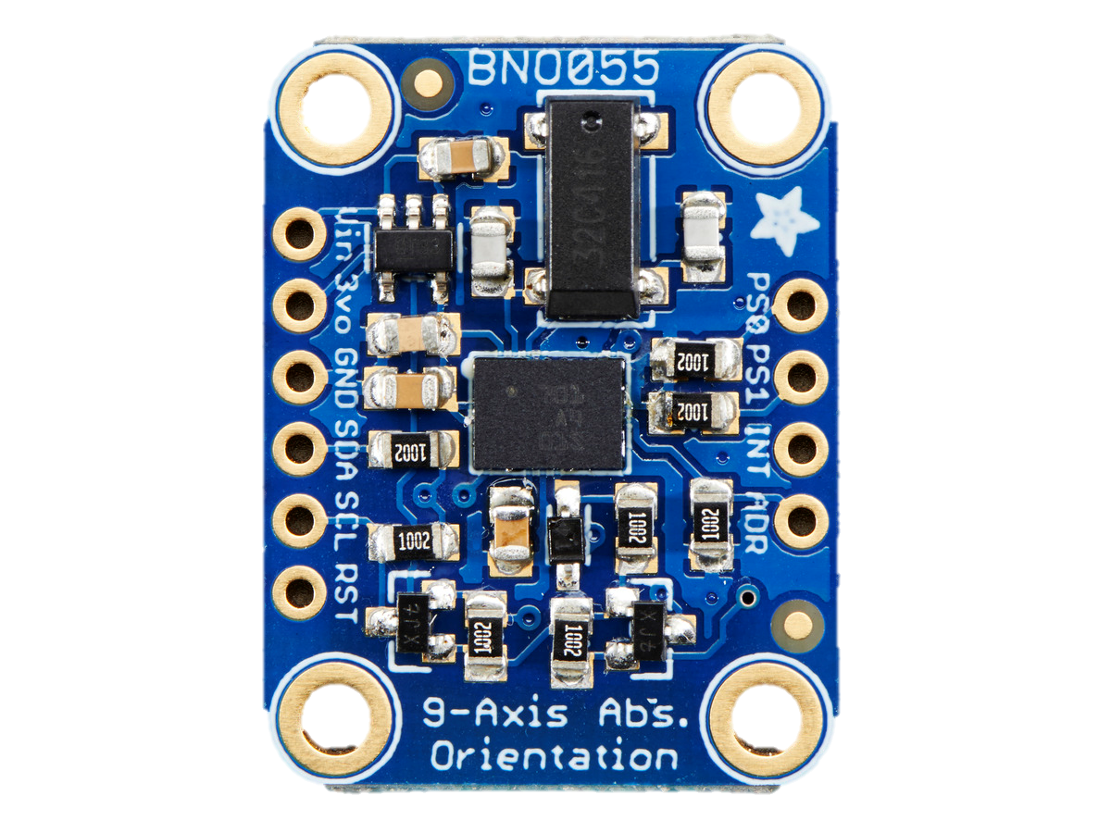
BNO055 IMU
Raspberry Pi 4 Model B

Slide 4
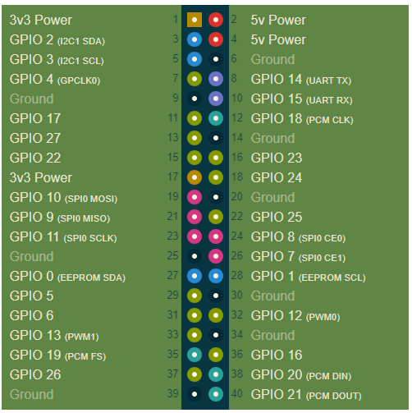
Power Supply
3.3V, 5V, 12V, 28V

Slide 5
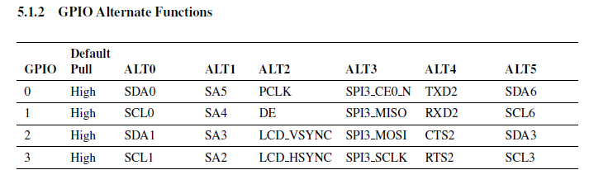
Pin Configuration for IMU
GPIO Pins 2 and 3 are used for SDA and SCL and therefore need to be configured to use the ALT0 function.

Slide 6
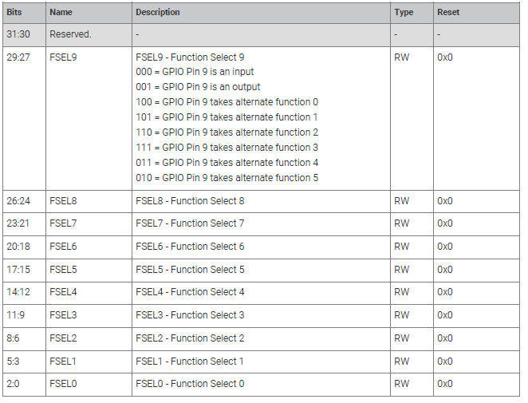
Configuring the GPFSEL0 register can be used to set the two pins into SDA and SCL mode. This register is located at 0x7e200000. Setting bits 8 and 11 will configure the two pins into SDA and SCL.

